Slide 1
Attribute based Access control policy mining
Gunjan Batra

Slide 2
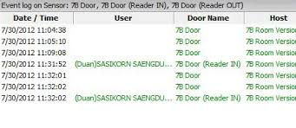
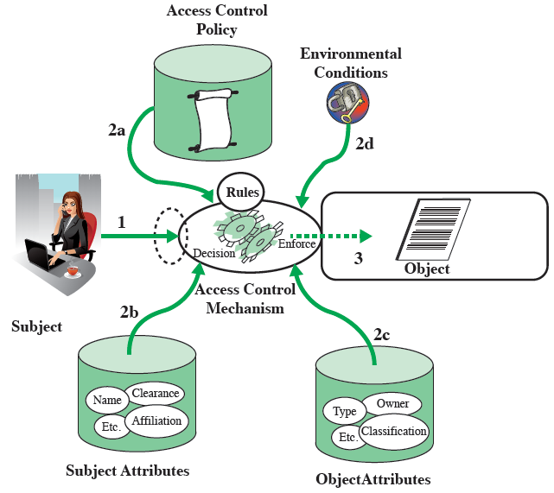
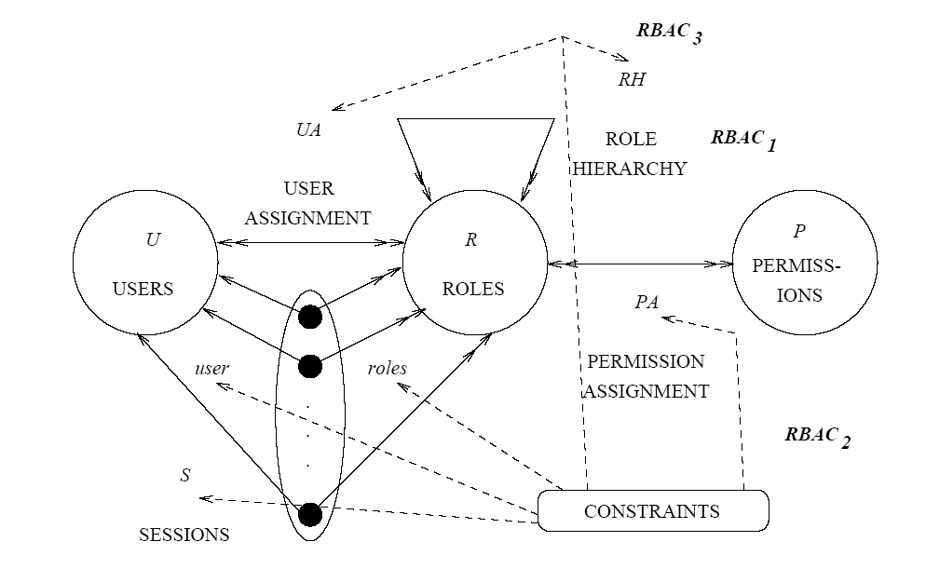
Types of Access Controls
File 1
File 2
U:r
U:w
U:own
U:r
V:r
V:w
V:own
Access Control Lists (ACL)
Access Logs
Role Based Access Control (RBAC)
Attribute Based Access Control (ABAC)

Slide 3
General Methodology
Input :
Add Noise
Apply Policy Mining Algorithm
ACL and attribute data
Logs and attribute data
RBAC policies and attribute data
Compatible with
ABAC Policy
ABAC Policy generated by Policy Mining Algorithm
Comparison

Slide 4
Policy Mining Problem – 1 Mining Attribute-Based Access Control Policies From ACLs
An access control list (ACL) policy is a tuple ⟨U;R; Op;UP₀ ⟩, where U is a set of users, R is a set of resources, Op is a set of operations, and UP₀ ⊆ U X R X Op is a user-permission relation, obtained from the union of the access control lists.
An ABAC policy is a tuple ‹U;R; Op;A_{u};A_{r}; d_{u}; d_{r};Rules ›, where U, R, A_{u}, A_{r}, d_{u}, and d_{r} are as described above, Op is a set of operations, and Rules is a set of rules.
An ABAC policy π is consistent with an ACL policy if they have the same sets of users, resource, and operations and [[π]] = UP₀.
The ABAC policy mining problem is:
Given an ACL policy π ₀ = ⟨U;R; Op;UP₀ ⟩, user attributes A_{u}, resource attributes A_{r}, user attribute data d_{u}, resource attribute data d_{r}, and a policy quality metric Q_{pol},
find a set Rules of rules such that the ABAC policy π = ‹U;R; Op;A_{u};A_{r}; d_{u}; d_{r};Rules› that
(1) is consistent with π ₀
(2) uses uid only when necessary,
(3) uses rid only when necessary, and
(4) maximum policy quality metric – Q_{pol ,} that reflects the size and meaning of the policy
Create a rule corresponding to each UP tuplein the ACL policy.

Slide 5
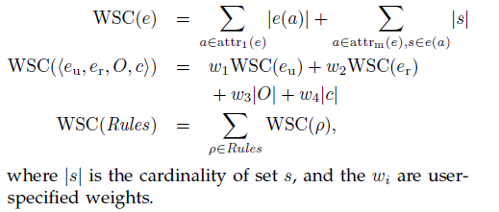
Policy Quality Metric
Policy Quality metric is a function Q_{pol} from ABAC policies to a totally ordered set. Ordering is chosen such that small values indicate high quality
The policy quality metric that our algorithm aims to optimize is weighted structural complexity (WSC), a generalization of policy size. This is consistent with usability studies of access control rules, which conclude that more concise policies are more manageable. Informally, the WSC of an ABAC policy is a weighted sum of the number of elements in the policy. Formally, the WSC of an ABAC policy with rules Rules is WSC(Rules), defined by

Slide 6
Data
The statement rule(uae; pae;ops; con) defines a rule; the four components of this statement correspond directly to the four components of a rule
Uae=User attribute expression
Rae=resource attribute expression
Ops=Operations
Con=Constraints
UNIVERSITY SAMPLE POLICY
User attributes include :
position (applicant,student, faculty, or staff),
department (the user’s department),
crsTaken (set of courses taken by a student),
crsTaught (set of courses for which the user is the instructor (if the user is a faculty) or the TA (if the user is a student), and
isChair (true if the user is the chair of his/her department).
Resource attributes include :
type (application, gradebook, roster, or transcript),
crs (the course a gradebook or roster is for, for those resource types),
student (the student whose transcript or application this is, for type=transcript or type=application), and
department (the department the course is in, for type 2 fgradebook; rosterg; the student’s major department, for type=transcript).
Data set
Manual - few instances of each type of user and resource, two academic departments, a few faculty, a few gradebooks,, several students, a few staff in each of 2 administrative departments(admissions office and registrar)
Synthetic – A series of synthetic attribute datasets was generated - parameterised by number of academic department.

Slide 7
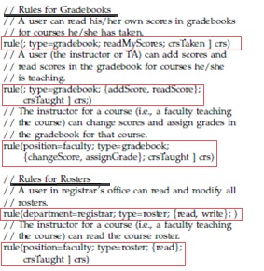
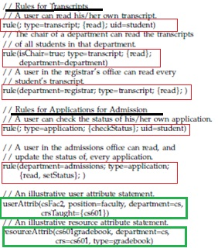
Data

Slide 8
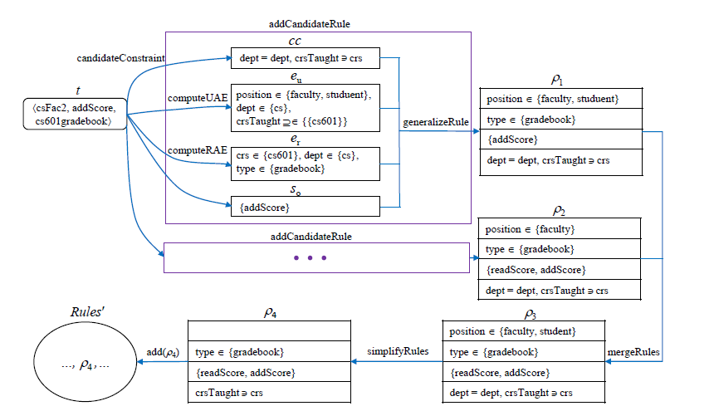
Algorithm

Slide 9
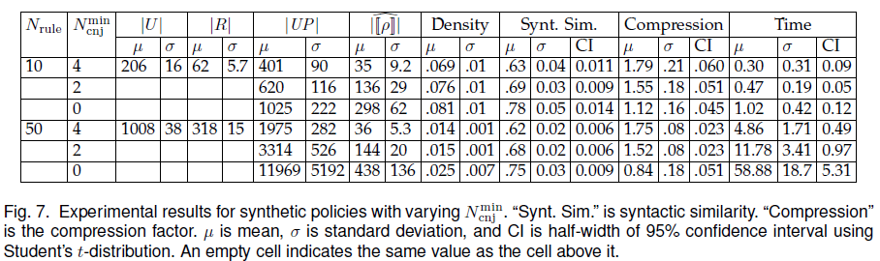
Evaluation : Synthetic Policies- Results for Varying Number of Conjuncts
They generated synthetic policies with N_{rule} ranging from 10 to 50 in steps of 20, with N_{mincnj} ranging from 4 to 0, and with N_{mincns} = 0
For each value of Nrule, as the number of conjuncts decreases, |UP| increases (because the numbers of users and resources satisfying each rule increase), the syntactic similarity increases (because as there are fewer conjuncts in each rule in the synthetic policy, it is more likely that the remaining conjuncts are important and will also appear in the mined policy), and the compression factor decreases (because as the policies get more similar, the compression factor must get closer to 1).
For example, for Nrule = 50, as Nmincnj decreases from 4 to 0, average |UP|increases from 1975 to 11969, average syntactic similarity increases from 0.62 to 0.75, and average compression factor decreases from1.75 to 0.84

Slide 10
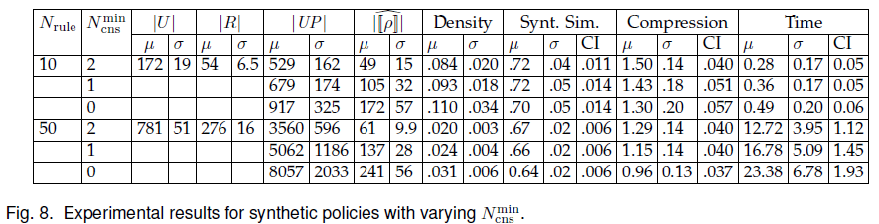
Evaluation : Synthetic Policies- Results for Varying Number of Constraints
They generated synthetic policies with N_{rule} ranging from 10 to 50 in steps of 20, with N_{mincns} ranging from 2 to 0, and with N_{mincnj} = 0.
For each value of Nrule, as the number of constraints decreases, |UP| increases (because the numbers of users and resources satisfying each rule increase), syntactic similarity decreases (because the algorithm gives preference to constraints over conjuncts, so when Nmincns is small, the mined policy tends to have more constraints and fewer conjuncts than the synthetic policy), and the compression factor decreases (because the additional constraints in the mined policy cause each rule in the mined policy to cover fewer user-permission tuples on average, increasing the number of rules and hence the WSC).
For example, for Nrule = 50, as Nmincns decreases from 2 to 0, average jUPj increases from 3560 to 26472, average syntactic similarity decreases slightly from 0.67 to 0.64, and average compression factor decreases from 1.29 to 0.96.
Notes:
For each value of N_{rule}, policies with smaller N_{mincns} are obtained by removing constraints from synthetic policies with larger N_{mincns}

Slide 11
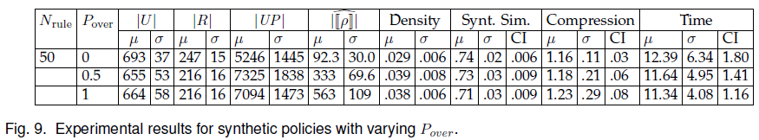
Evaluation : Synthetic Policies- Results for Varying Overlap between Rules
They generated synthetic policies with 30 rules.
For each value of Nrule, they generated synthetic policies with Pover ranging from 0 to 1 in steps of 0.25, and with N_{mincnj} = 2 and N_{mincns} = 0
For each value of N_{rule}, as P_{over} increases, the syntactic similarity decreases (because algorithm effectively removes overlap, i.e., produces policies with relatively little overlap), and the compression factor increases (because removal of more overlap makes the mined policy more concise).
For example, for N_{rule} = 50, as P_{over} increases from 0 to 1, the syntactic similarity decreases slightly from 0.74 to 0.71, and the compression factor increases from 1.16 to 1.23.

Slide 12
Policy Mining Problem – 2 Mining Attribute based Access Control policies from Logs
An operation log is a sequence of logs. The log entry e is defined as a tuple <u, r, o, t> where u ∈ U is a user, r ∈ R is a resource, o ∈ Op is an operation, and t is a timestamp.
The input to the ABAC-from-logs policy mining problem is a tuple I = <U,R, Op ,Au, Ar, du, dr, L>, where U is a set of users, R is a set of resources, Op is a set of operations, Au is a set of user attributes, Ar is a set of resource attributes, du is user attribute data, dr is resource attribute data, and L is an operation log, such that the users, resources, and operations that appear in L are subsets of U, R, and Op, respectively.
The problem is defined assuming that attribute data does not change during the time covered by the log.
The problem is to find a set of rules Rules such that the ABAC policy π = <U, R, Op, A_{u}, A_{r}, d_{u}, d_{r}, Rules> maximizes a suitable policy quality metric.

Slide 13
Mining Attribute based Access Control policies from Logs
Challenge - Logs give incomplete information about granted permissions.
They provide only a lower bound on the entitlements. Therefore, the generated policy needs to include over-assignments
Changes were done to algorithm for mining ABAC policies from ACLs to adapt it to mining from logs.
When the algorithm generalizes, merges, or simplifies rules, it discards candidate rules that produce over-assignments. This part was modified to consider those candidate rules, because over-assignments must be permitted in logs.
For those candidate rules, they introduced generalized notions of rule quality and policy quality that quantify a trade-off between the number of over assignments and other aspects of quality.
Notes:
The main challenge with logs is that they give incomplete information about granted permissions. They provide only a lower bound on the entitlements. Therefore, the generated policy needs to include over-assignments, i.e., entitlements not reflected in the logs.
Similar to [1], this algorithm iterates over tuples in the user-permission relation extracted from the log, uses selected tuples as seeds for constructing candidate rules, and attempts to generalize each candidate rule to cover additional tuples in the user-permission relation by replacing conjuncts in attribute expressions with constraints.
After constructing candidate rules that together cover the entire user-permission relation, it attempts to improve the policy by merging and simplifying candidate rules.
Finally, it selects the highest quality candidate rules for inclusion in the generated policy.

Slide 14
Mining Attribute based Access Control policies from Logs
generalizeRule(ρ, cc, uncovUP, Rules) returns the generalization ρ’ of ρ with the best quality according to a given rule quality metric.
ρ’ may cover tuples that are already covered (i.e., are in UP i.e. rules whose meanings overlap.
A rule quality metric is a function Qrul(ρ,UP) that maps a rule ρ to a totally ordered set, with the ordering chosen so that larger values indicate high quality. The second argument UP is a set of user-permission tuples.
The rule quality metric Qrul(ρ,UP) assigns higher quality to rules that cover more currently uncovered userpermission tuples and have smaller size, with an additional term that imposes a penalty for over-assignments, measured as a fraction of the number of userpermission tuples covered by the rule, and with a weight specified by a parameter w’o, called the rule over-assignment weight.

Slide 15
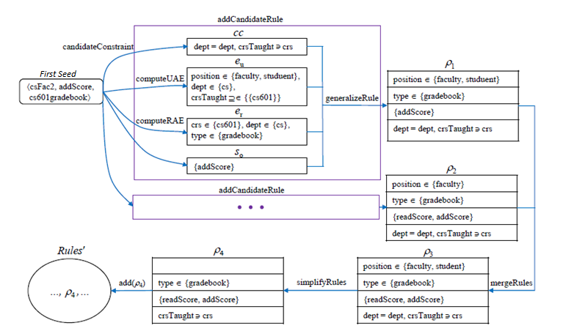
Policy Mining Algorithm
Input : Operation Log L
csFac2, cs601gradebook, addScore, t1
csFac2, cs601gradebook, readScore, t2
csStu3, cs601gradebook, addScore, t3}.
Notes:
Using a single rule ρ0 =< true, type ∈ {gradebook}, {addScore, readScore}, crsTaught ϶ crs > and all of the attribute data from the full case study, except attribute data for gradebooks for courses other than cs601.
Considering an operation log L containing three entries: {csFac2, cs601gradebook, addScore, t1
csFac2, cs601gradebook, readScore, t2
csStu3, cs601gradebook, addScore, t3}.
User csFac2 is a faculty in the computer science department who is teaching cs601; User attributes are position = faculty, dept = cs, and crsTaught ={cs601}.
User csStu3 is a CS student who is a TA of cs601; User attributes are position =student, dept = cs, and crsTaught = {cs601}.
Resource cs601gradebook is a resource with resource attributes type = gradebook, dept = cs, and crs = cs601.
The algorithm selects user-permission tuple :
csFac2, cs601gradebook, addScore as the first seed
It calls function:
candidateConstraint to compute the set of atomic constraints that hold between csFac2 and cs601gradebook; the result is cc = {dept = dept, crsTaught crs}.
addCandRule is called twice to compute candidate rules.
The first call to addCandRule calls computeUAE to compute a UAE eu that characterizes the set su containing users with permission addScore, cs601gradebook and with the same candidate constraint as csFac2 for cs601gradebook; the result is
eu = (position ∈ {faculty, student} ∧ dept ∈ {cs} ∧ crsTaught ⊇ {{cs601}}).
addCandRule also calls computeRAE to compute a resource-attribute expression that characterizes cs601gradebook}; the result is
er = (crs ∈ {cs601} ∧ dept ∈ {cs} ∧ type ∈ {gradebook}).
The set of operations considered in this call to addCandRule is simply so = {addScore}. addCandRule then calls generalizeRule, which generates a candidate rule ρ1 which initially has eu, er and so in the first three components, and then atomic constraints in cc are added to ρ1, and conjuncts in eu and er for attributes used in cc are eliminated; the result is
ρ1 =<position ∈ {faculty, student}, type∈{gradebook}, {addScore}, dept = dept ∧ crsTaught ϶ crs>, which also covers the third log entry.
The second time addCandRule is called it generates a candidate rule
ρ2 = <position ∈ {faculty}, type ∈ {gradebook}, {addScore, readScore}, dept = dept ∧crsTaught ϶ crs>, which also covers the second log entry.
All of UP(L) is covered, so our algorithm calls mergeRules, which attempts to merge ρ1 and ρ2 into rule
ρ3=< position ∈ {faculty, student}, type ∈ {gradebook}, {addScore, readScore}, dept = dept ∧ crsTaught ϶ crs>.
ρ3 is discarded because it introduces an over-assignment while ρ1 and ρ2 do not.
simplifyRules is called, which first simplifies ρ1 and ρ2 to ρ1' and ρ2’, respectively, and then eliminates ρ1’ because it covers a subset of the tuples covered by ρ2’. The final result is ρ2’, which is identical to the rule ρ0 in the original policy.

Slide 16
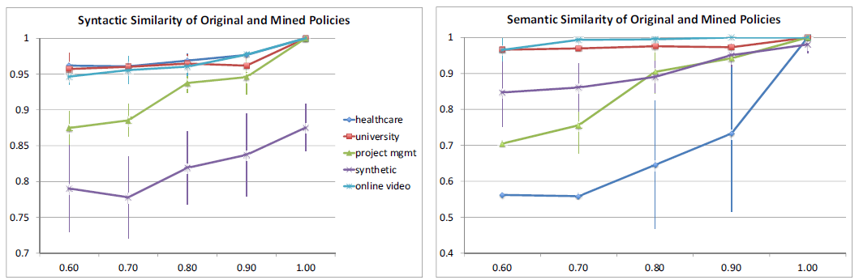
Evaluation
Syntactic and Semantic Similarity of original and mined ABAC policy as function of log completeness.
For log completeness 100% - all four case study policies are reconstructed exactly
Syntactic similarity for all four case studies is above 0.87 for log completeness 60% or higher, and is above 0.93 for log completeness 80% or higher
Semantic similarity is above 0.7 for log completeness 60% or higher, and above 0.89 for log completeness 80% or higher, for synthetic policies and for case studies other than healthcare.

Slide 17
Policy Mining Problem – 3 Mining Attribute-Based Access Control Policies from RBAC Policies
We need to mine an ABAC policy that is semantically consistent with a given RBAC policy and preserves the structure of the RBAC policy
The ABAC-from-RBAC policy mining problem is: given an RBAC policy π_{RBAC} = 〈U, Res, Op, Roles, UA, PA, RH〉, attribute data 〈A_{u}, A_{r}, d_{u}, d_{r} 〉, and a policy quality metric Qpol, find a set Rules of rules such that the ABAC policy π = 〈U, Res, Op, A_{u}∪{roles}, Ar, d’_{u}, d_{r}, Rules〉
(1) is semantically and structurally consistent with RBAC π ,
(2) does not use uid,
(3)uses roles and rid only when necessary, and
(4) has the best quality, according to Q_{pol}, among policies that satisfy conditions (1) through (3).

Slide 18
Policy Mining Problem – 3 Mining Attribute-Based Access Control Policies from RBAC Policies
Challenge –
1-to-1 correspondence between roles and rules; i.e., for each role r, the mined policy has a rule that covers the same user-permission tuples is not is good idea because –
Some roles cannot be expressed as a single rule
Desirable to express multiple related roles by a single rule
Solution –
First, split the given roles, so that each role’s set of assigned permissions is the Cartesian product of a set of resources and a set of operations, and we require a correspondence between the resulting split roles and the mined rules.
Second, allow multiple roles to correspond to a single rule
P is expressed as union of Cartesian products
P=U< R,O>∈SOP(P) R×O

Slide 19
Example
In the University case study,
Roles were defined for
students in each course
TA in each course
Instructor of each course
chairman of each department, registrar staff,
admissions staff, and
applicants for admission.
The permission assignment allows
A student to read his/her transcript,
an instructor to assign grades for courses he/she teaches…
Further the policy was implemented in similar fashion as in examples above

Slide 20
Policy mining Algorithm
The algorithm has following steps:
Splits the roles in RBAC policy so that each role’s assigned permissions are Cartesian product of set of resources and set of operations. This is important so that each role can be translated into a single rule
It constructs an ABAC policy rule corresponding to each role
Improve the algorithm by merging and simplifying rules

Slide 21
Evaluation
Evaluation was performed on manually written case studies.
They manually wrote semantically consistent case study policies in RBAC and ABAC, applied the algorithm to the RBAC policy and accompanying attribute data, and compared the generated ABAC policy with the manually written one.
The experiments with Full Attribute Data demonstrated that, when all relevant attribute data is available, the algorithm successfully produces an intuitive high-level ABAC policy from an RBAC policy.
Experiments with Incomplete Attribute Data demonstrate that, when some relevant attribute information is unavailable, the algorithm successfully produces an intuitive high-level ABAC policy that uses the available attribute data and uses role membership information as a substitute for missing attribute data

Slide 22
FUTURE RESEARCH
There is further scope in the study of ABAC policy mining algorithms based on data mining techniques and machine learning.
The language features and constructs used in the papers were basic. More language features and complex arithmetic constructs can be added to the work.
We also need to figure out which attributes to use for constructing the rules from a vast number of available attributes.
Future work can include using attributes of environment conditions and risk levels to determine access policy

Slide 23
References
Zhongyuan Xu and Scott D. Stoller. Mining Attribute-Based Access Control Policies. IEEE Transactions on Dependable and Secure Computing 12(5):533-545, September-October 2015.
Zhongyuan Xu and Scott D. Stoller. Mining Attribute-Based Access Control Policies from Logs. In Proceedings of the 28th Annual IFIP WG 11.3 Working Conference on Data and Applications Security and Privacy (DBSec 2014)
Zhongyuan Xu and Scott D. Stoller. Mining Attribute-Based Access Control Policies from Role-Based Policies. In Proceedings of the 10th International Conference & Expo on Emerging Technologies for a Smarter World (CEWIT 2013). © IEEE Press, 2013

Slide 24
Thank You
Questions??

